Slide 1
SD5959 Psychology of Design II Class 2B: YOUR BRAINS
School of Design
The Polytechnic University of Hong Kong

Slide 2
IMPORTANT
Please sit with the members
of your final group project

Slide 3
The Brain Is A Complex Organ
It has two hemispheres
It has some very old parts
It has some very new parts
It works in very strange ways
It has parts we don’t understand
We do not know where “YOU” are
Consciousness is mysterious to us

Slide 4
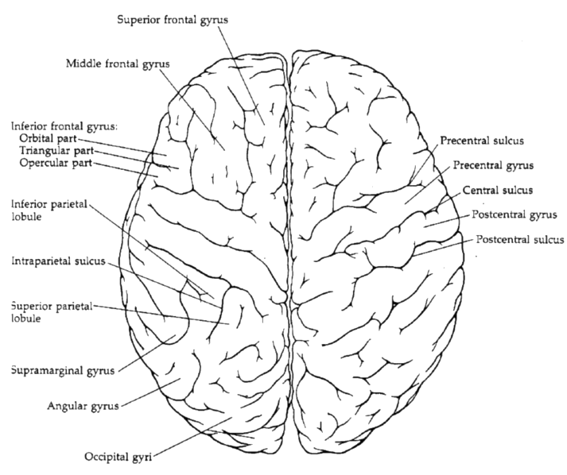
The Brain, Dorsal View
http://homepages.widged.com/mlange/teaching/CNL/helpers/Dorsal.gif

Slide 5
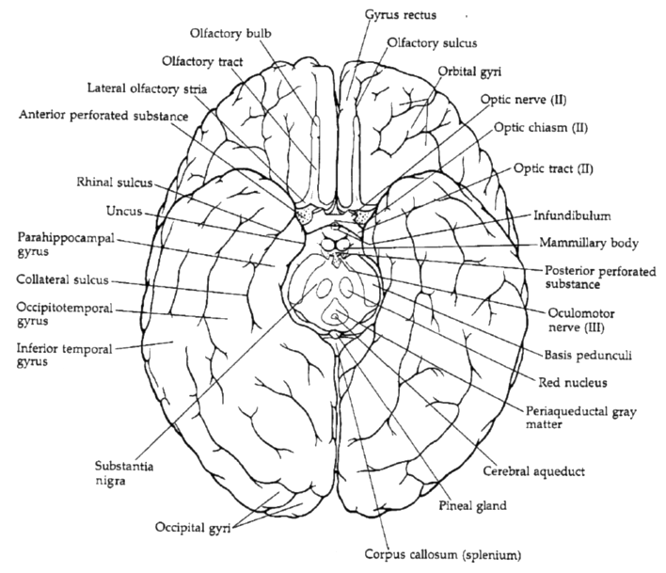
The Brain, Ventral View
http://homepages.widged.com/mlange/teaching/CNL/helpers/ventral.gif

Slide 6
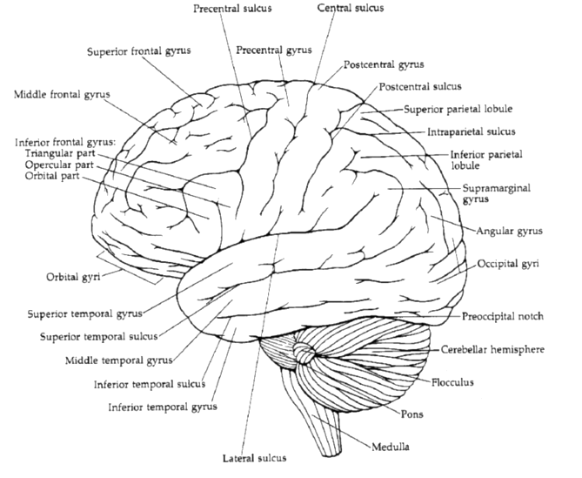
The Brain, Lateral View
http://homepages.widged.com/mlange/teaching/CNL/helpers/lateral.gif

Slide 7
You Get The Picture
What’s Much More Interesting Is How The Brain Works!

Slide 8
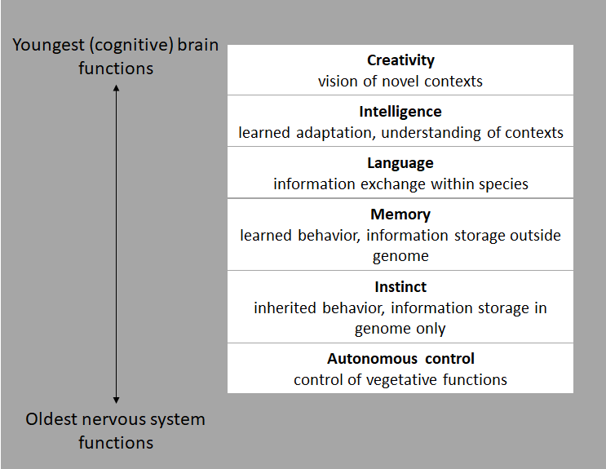
The Brain Is A Multi-State Machine
Hierarchy of Nervous System Functions
(Pfenniger, 2001, p. 91, Table 2.2)

Slide 9
Here’s How We Perceive Reality
Undefined
Probabilistic
Opportunity
Unstructured
Survival
Deterministic
Structured
Defined

Slide 10
How About A Map?
(Re)Introducing Maslow

Slide 11
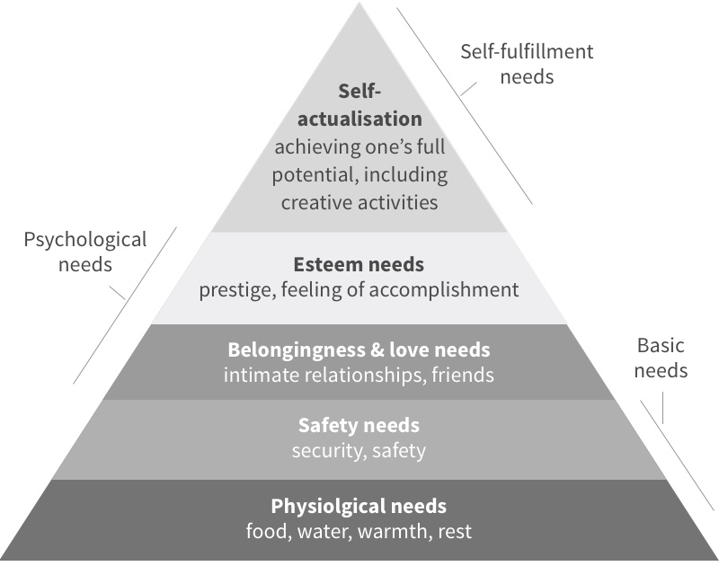
Maslow’s Hierarchy of Needs
Opportunity
Survival
https://mrjoe.uk/assets/Maslows-Hierarchy-of-Needs.jpg

Slide 12
The Consciousness Rule
The Brain monitors constantly for shifts from the Expected and the Unexpected.
The Unexpected is always felt as danger.
Until that danger has been mitigated, the brain kicks into a lower, survival-oriented mode.
Only people who do not feel they are in danger can operate at higher levels of the pyramid.
The signal that someone is operating at a high state of consciousness is exploratory play.

Slide 13
Questions?
Discussion

Slide 14
Thank You

