Slide 1
SD5953
Successful Project Management
PROJECT DANGERS
School of Design
The Polytechnic University of Hong Kong

Slide 2
IMPORTANT
Please sit with the members
of your final group project

Slide 3
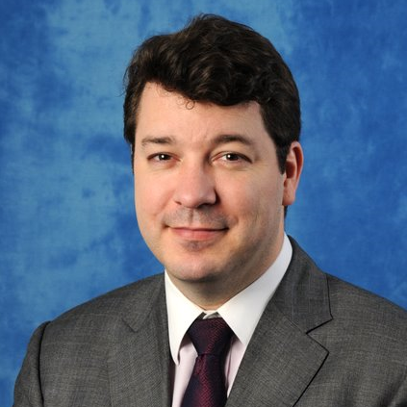
Graham Leach, Instructor
www.graham-leach.com
polyusd5953@gmail.com

Slide 4
Project Management Dangers

Slide 5
Losing Perspective
Thinking about activities is much easier than thinking about the outcomes the activities are pursuing. It is easy to lose perspective when you fall behind, or fall in too deep.
When losing perspective, the PM receives an assignment, and only thinks about the first thing that needs doing. They only think about the next step only when they come to it.
Losing perspective has ruined countless projects because it wastes resources and frustrates project team members with continuously changing tasks, goals and assignments.

Slide 6
Scope Creep
At the outset, clearly outline the deliverables of the project with the Customer in terms of business objective(s) that they want the project to accomplish.
The Customer must tell you how the project will be judged and measured, otherwise you run the risk of Scope Creep.
Being this explicit at the beginning may cause discussion and disagreement, but it is far better to work through this before you start work rather than discovering “surprise” measures of success when you thought you were almost done.

Slide 7
Pressure
The Executives or customer in question has just finished telling you what they want, along with a few desired features. Their next statement is inevitably “How soon can I have it?”
Remember, to maintain project focus, you need to be able to drive the projects from a mutually agreed, unambiguous, quantifiable Scope defined by Measures of Success (MOS).
Resist the pressure to make a commitment at this stage! You need to really map things out, generate accord and develop buy-in.

Slide 8
Politics
Ask for the resources you need and the authority to manage them during the charter process because your chances of getting some level of authority are far better in this stage than later on.
For example, you might say, “I need approximately 50 hours of Jill’s time during the next 60 days. Is it possible to adjust her workload to make these hours available and also please tell her that I will be assigning her work within that period of time. Also, I would like my evaluation of her work will be considered in her quarterly performance review.”

Slide 9
Questions?

Slide 10
Thank You

