Slide 1
SD5953 Successful Project Management LAB B
School of Design
The Polytechnic University of Hong Kong

Slide 2
IMPORTANT
Please sit with the members
of your final group project

Slide 3
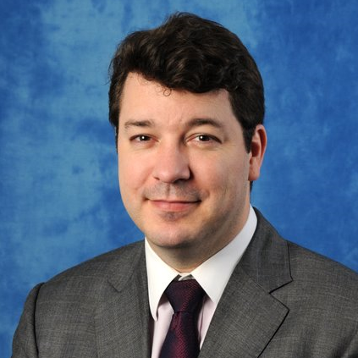
Graham Leach, Instructor
www.graham-leach.com
polyusd5953@gmail.com

Slide 4
LAB B2
JOB 2:
Reproduce the HR Service Improvement Project in MS-Project

Slide 5
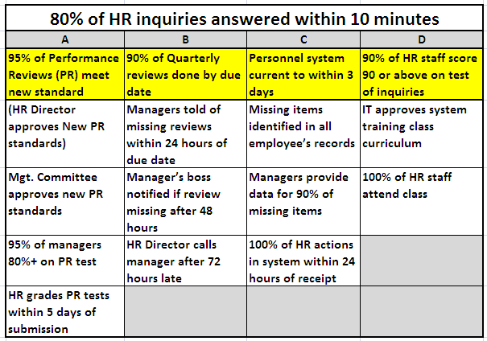
HLDN

Slide 6
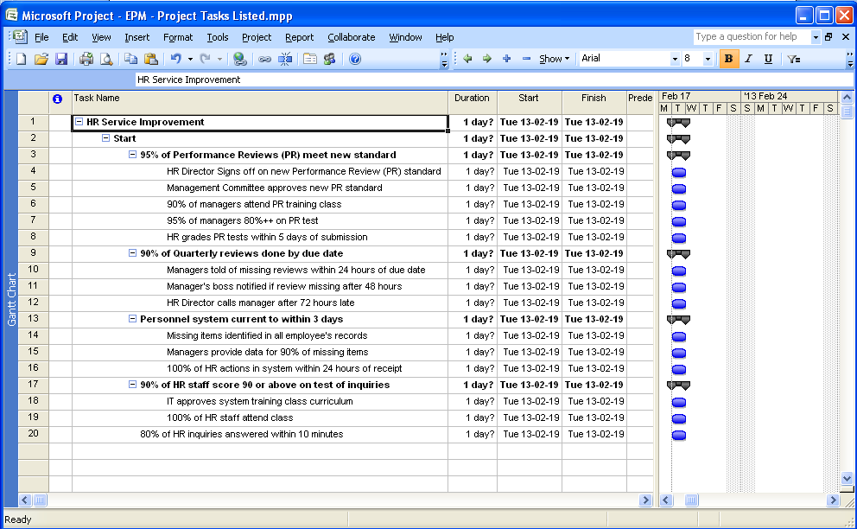
What You Should Be Producing

Slide 7
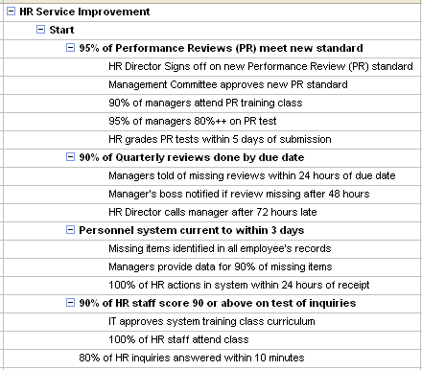
Detailed View of MS-Project View

Slide 8
Questions?

Slide 9
Thank You

