Slide 1
SD5953 Successful Project Management REVIEW 3
School of Design
The Polytechnic University of Hong Kong

Slide 2
IMPORTANT
Please sit with the members
of your final group project

Slide 3
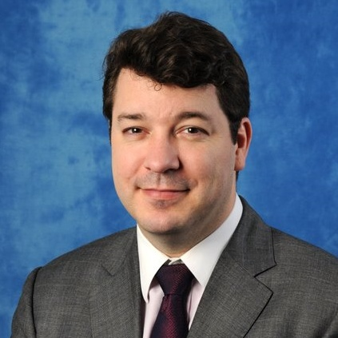
Graham Leach, Instructor
www.graham-leach.com
polyusd5953@gmail.com

Slide 4
Project Dangers

Slide 5
Project DANGERS
Perspective Getting lost in details too early
Scope Creep Allowing “extras” into the project
Politics Getting lost in people-driven issues
Pressure Letting customers push you around

Slide 6
The Project Charter

Slide 7
The Project Charter
The Project Charter is something that the project manager produces very early in the project process, typically right after their sponsor has indicated an openness towards a high level document like an Executive Summary or a Framing Exercise.
The Project Charter outlines the import and impact of the project to the attention of the sponsoring organization. At the same time, it also incorporates a methodology of measuring, guiding and/or managing the expectations that being at the “front of mind” of the organization can bring.

Slide 8
The Project Charter
The project charter helps to avoid social or political problems. It is the Project Managers best (and often, only) opportunity to inform the organization about the ideal CULTURE they feel will be best for themselves and the project they will lead.
With the Project Charter, the Project Manager can build a common concept of the project across the organization, focus everyone on its ultimate goal and muster the support, power and resources the project needs to be a success.

Slide 9
Charter Contents
The charter contains sections that individually address the six major areas of project failure:
Scope Expectations
Resource Availability
Change Control
PM Authority
Assumptions
Risks

Slide 10
QUESTIONS?

Slide 11
THANK YOU

