Slide 1
SD5953 Successful Project Management LAB C
School of Design
The Polytechnic University of Hong Kong

Slide 2
IMPORTANT
Please sit with the members
of your final group project

Slide 3
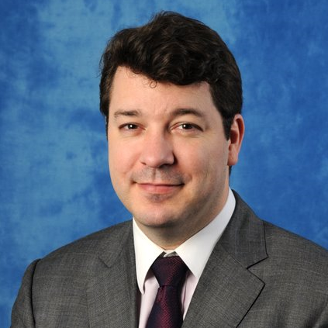
Graham Leach, Instructor
www.graham-leach.com
polyusd5953@gmail.com

Slide 4
The Wedding Project
Planning a wedding is very intimidating for most people. Why?
People generally get married very seldom in their life
Marriages are very expensive in terms of time and money
Marriages are very public with lots of “performance pressure”
So, many people use a Wedding Planner. These are (usually) very capable people with the experience of hundreds of weddings to draw upon to help you. But knowing a little about what they have to deal with will result in a much smoother wedding for you…and maybe even get you a better price from the planner!

Slide 5
TASK ONE
Develop 100 Tasks

Slide 6
Wedding Project – TASK 1
Your job today is to create an MS-Project to help plan a Wedding.
A well-developed project usually has at least 100 distinct tasks.
But, the file WEDDING_WBS.xlsx has only 80 tasks.
So, your first task is to add tasks until you have reached 100.

Slide 7
TASK TWO
Organize The 100 Tasks

Slide 8
Wedding Project – TASK 2
A well developed project has its tasks grouped in a logical way.
This enables the Tasks to be organized in such a way that their relationships may be more easily observed, and their potential sequencing be the most optimal.
Your second task is to us MS-Project (or the software of your choice) to group the Tasks into a 2-tier High Level Deliverables Network that achieves the Scope statement: “Get Married”.

Slide 9
Questions?

Slide 10
Thank You

