Slide 1
SD5953
Successful Project Management
FRAMING EXERCISE FEEDBACK
School of Design
The Polytechnic University of Hong Kong

Slide 2
IMPORTANT
Please sit with the members
of your final group project

Slide 3
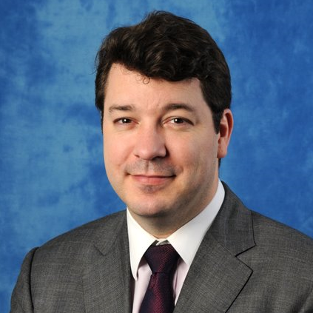
Graham Leach, Instructor
www.graham-leach.com
polyusd5953@gmail.com

Slide 4
FRAMING EXERCISE FEEDBACK

