Slide 1
SD5953 Successful Project Management OUTSOURCING
School of Design
The Polytechnic University of Hong Kong

Slide 2
IMPORTANT
Please sit with the members
of your final group project

Slide 3
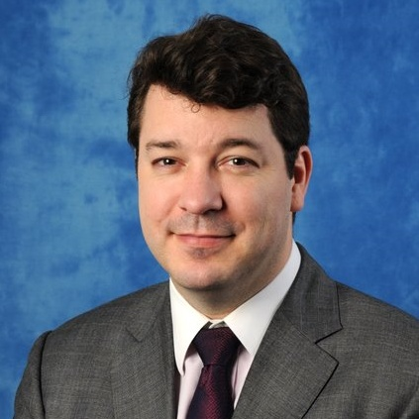
Graham Leach, Instructor
www.graham-leach.com
polyusd5953@gmail.com

Slide 4
OUTSOURCING
Writing Professional Specifications
Intellectual Property Rights
Interviewing and Hiring
Team Building

Slide 5
Writing Professional Specifications
Professionally prepared specifications really do matter
They help organize your thinking.
They serve to dramatically reduce risk.
They act as a “permanent memory” of what was agreed to
They are the legal body of knowledge for a 3rd party judge
When prepared correctly, they help a project go smoothly
Never, ever engage someone to work for you without them!

Slide 6
Intellectual Property Rights
There are two very important aspects of Intellectual Property rights that you need to consider when outsourcing:
Be sure your contract stipulates that you are to receive not only the object code of your project, but also all supporting documents, notes, source code, development environment & IDE specifications and so forth, so you can change things if necessary. The contractor should also do a knowledge transfer.
Be sure that your legal paperwork clearly states that this is a “Work for Hire” contract with them assigning you all IP Rights.

Slide 7
Interviewing
Interviewing is one of the most crucial, yet overlooked skills of a Project Manager. Without the right Human Capital, you project will not be a success – yet many people do not make their hiring decisions on a rational basis – instead, they tend to hire people they “like” socially instead of people they “need” technically.
Focus on their technical background
Ask for examples of their work, especially relevant ones
Be structured, ask the SAME questions of all your applicants
Score everyone according to the same metric
CALL THEIR REFERENCES

Slide 8
Team Building
Once the project team has been assembled, the next challenge for the Project Manager is to hold everything together long enough for the project to deliver on its promises.
This can be hard to do as internal and external stresses begin to exert pressure on the project and everyone involved with the project. The two major risks that the Project Manager needs to watch out for are Black Swan Change and Internal Politics.
Continuous ongoing Team Building will help create a cohesive, resilient team capable of absorbing both risk types.

Slide 9
QUESTIONS?

Slide 10
THANK YOU

