Slide 1
SD5953 Successful Project Management SCRUM
School of Design
The Polytechnic University of Hong Kong

Slide 2
IMPORTANT
Please sit with the members
of your final group project

Slide 3
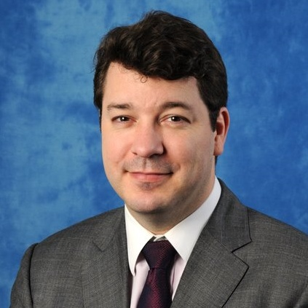
Graham Leach, Instructor
www.graham-leach.com
polyusd5953@gmail.com

Slide 4
SCRUM
An AGILE
Project Management
Methodology

Slide 5
The Basics of Scrum
While there are several candidates we could examine within the Agile Methodology family, Scrum is one of the most used popular and well-developed approaches available when it comes to managing projects in an Agile way.
Scrum divides the responsibilities within a project between:
The Product Owner
The Scrum Master
The Team
http://www.mountaingoatsoftware.com/topics/agile-project-management

Slide 6
AGILE PM – The Product Owner
The Product Owner:
Is responsible for the business aspects of the project, including making sure that the right product continues to be built – and that its priorities are in the right order.
A good product owner:
Can balance competing priorities
Is available to the team throughout the process
Is empowered to make decisions about the product
http://www.mountaingoatsoftware.com/topics/agile-project-management

Slide 7
AGILE PM – The Scrum Master
The ScrumMaster:
Acts as the team's coach, helping team members work together in the most effective manner possible.
Serves the team by removing impediments, facilitating meetings and encouraging discussion.
Performs some of the “classic” project management duties, such as tracking progress and issues.
http://www.mountaingoatsoftware.com/topics/agile-project-management

Slide 8
AGILE PM – The Team
The Team:
Assumes responsibility for creating the product as defined by the product owner.
Collectively decides as to who works on what as well as the technical approach required to achieve target quality goal
Performs the necessary work to achieve the product

Slide 9
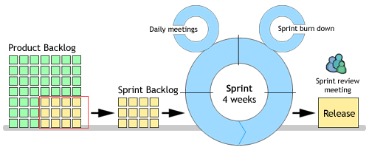
Scrum Sprint Planning
http://www.targetprocess.com/userguides/guides/user-guide/scrum.gif

Slide 10
Scrum Ceremonies
In the most general sense, when agile practitioners talk about a project ceremony, they are talking about the formal activities that the project membership observes on a regular basis to forge and support forward progress.
Scrum uses the following ceremonies to move projects along:
Sprint Planning
Daily Meeting
Sprint Review

Slide 11
Sprint Planning
Sprint Planning is an integral component of the AGILE process.
Sprint Planning is usually time-boxed to a maximum of 8 hours to plan an entire month of work, but can be even shorter if the Sprint Increment is less than a month (normal duration).
Sprint Planning process answers the following questions:
What work is to be delivered in the next Sprint?
What inputs are needed to enable the next Sprint?

Slide 12
Daily Meeting
The Daily Meeting is an integral part of the agile approach.
They usually have a strict 15 minute time limit, and they are for issuing status updates, not problem-solving or planning.
Each team member simply explains to the rest of the team:
What they accomplished since the last meeting.
What they intend to accomplish for the next meeting.
What impediments they’ve found or expect to encounter.
http://www.techrepublic.com/blog/tech-manager/three-ceremonies-to-conduct-in-scrum-projects/3187

Slide 13
Sprint Review - A
A guiding principle of agile methods is the feedback loop.
Agile practitioners stress the importance of continuously improving the content and the process that delivers it.
Sprint Reviews are where the course of the project gets corrected as to ensure that it will deliver relevant business benefits.
http://www.techrepublic.com/blog/tech-manager/three-ceremonies-to-conduct-in-scrum-projects/3187

Slide 14
Sprint Review - B
Sprint Reviews are usually time-boxed to a 4 hour maximum.
Everyone attends these meetings – external and internal representatives alike.
Everyone evaluate the progress made, and feedback is given.
Changes that may have an effect on the project (market, technology, business value) are discussed and any necessary adjustments are made.
http://www.techrepublic.com/blog/tech-manager/three-ceremonies-to-conduct-in-scrum-projects/3187

Slide 15
QUESTIONS?

Slide 16
Scrum Related YouTube Videos
What is Agile Software Development and Scrum?
http://www.youtube.com/watch?v=Jj83I4_DmoM
Why is Scrum so Hard?
http://www.youtube.com/watch?v=q3t8twm3aUk
Going Agile with Scrum at Genius.com
http://www.youtube.com/watch?v=b9U6AtJwtBM

Slide 17
THANK YOU

